Slide 1
Pediatric Platform Trials
Freda W. Cooner, Ph.D.
Director, Statistical Innovation
Amgen Inc.
2019 ASA BIOP Workshop (Sep. 25)
The views expressed herein represent those of the presenter and do not necessarily represent the views or practices of the presenter’s employer or any other party.

Slide 2
Outline
Regulatory history and recent updates
Oncology pediatric program
Pediatric extrapolation
Oncology pediatric platform trials
Statistical modeling and simulation
Bayesian framework
Summaries

Slide 3
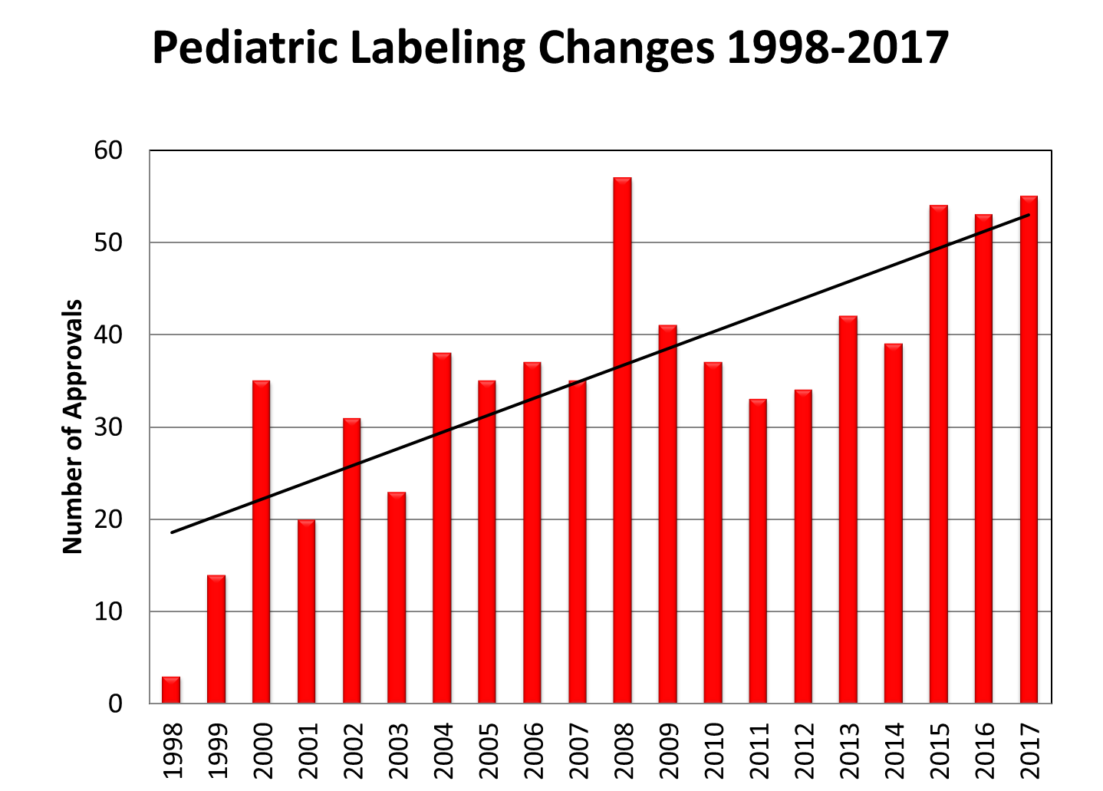
Regulatory Evolution
1977: American Academy of Pediatrics Committee on Drugs
1994: Pediatric Labeling Rule
1998: Pediatric Rule (requirement)
2003 Pediatric Research Equity Act (PREA)
2017: FDA Reauthorization Act (FDARA) – Research to Accelerate Cures and Equity (RACE) for Children Act
1979: Labeling Requirement
1997: FDA Modernization Act (FDAMA) Pediatric Exclusivity (incentive)
2002: Best Pharmaceuticals for Children Act (BPCA)
2007: FDA Amendments Act (FDAAA) – Reauthorize BPCA & PREA
2018: ICH E11 (R1)

Slide 4
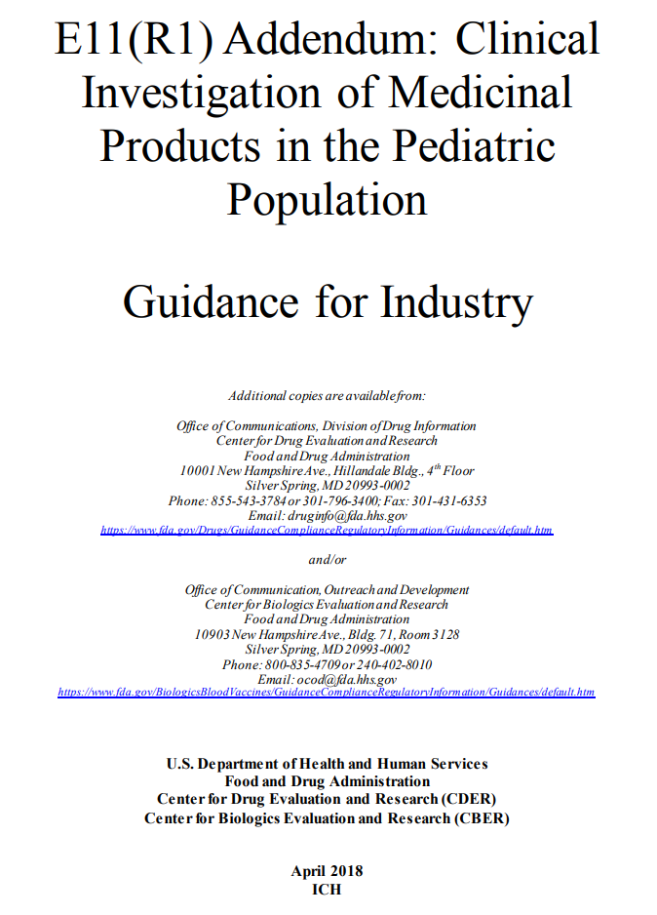
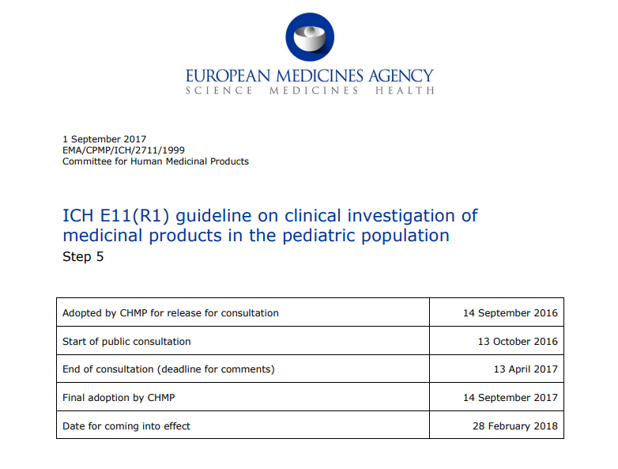
ICH E11 (R1)
The purpose of the addendum is to complement and provide clarification and current regulatory perspective on topics in pediatric drug development.
Supplement:
  Ethical Considerations
  Age Classification and Pediatric Subgroups including Neonates
  Pediatric Formulations
Address issues:
  Commonality of Scientific Approach for Pediatric Drug Development Programs
Additional contents:
  Approaches to Optimize Pediatric Drug Development (Extrapolation, Modelling and Simulation)

Slide 5
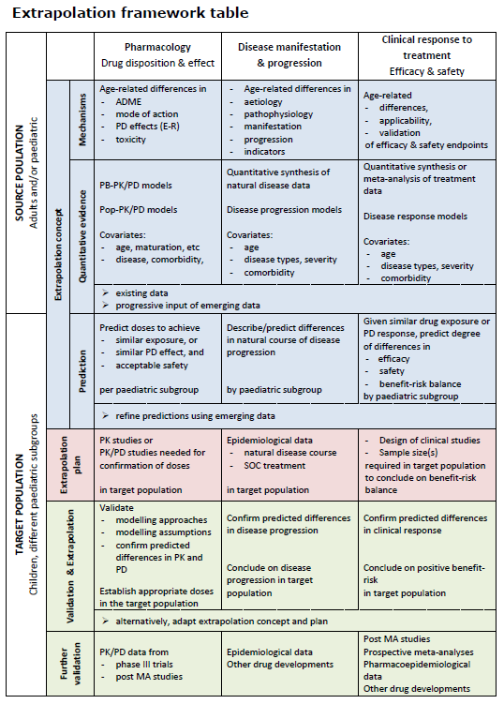
Lynne P. Yao, M.D. “Extrapolation in Pediatric Drug Development: an Evolving Science”:
2018 JSM
EMA Reflection paper on the use of extrapolation in the development of medicines for paediatrics, October, 2017

Slide 6
US Pediatric Drug legislation
PREA | BPCA
Drugs and biologics
Mandatory studies | Voluntary studies
Requires studies only on indication(s) under review | Studies relate to entire moiety and may expand indications
Orphan indications exempt from studies | Studies may be requested for orphan indications
Pediatric studies must be labeled

Slide 7
PREA Trigger
New indication
New dosage form
New dosing regimen
New route of administration
New active ingredient

Slide 8
PREA Automatic Full Waivers (Cancer)
Basal cell and squamous cell skin cancer
Bladder breast cervical colorectal
Cholangiocarcinoma
Endometrial
Esophageal
Fallopian tube
Follicular lymphoma
Gastric
Hairy cell leukemia
Hepatocellular
Indolent non-Hodgkin lymphoma
Liposarcoma lung (small & non-small cell)
Multiple myeloma
Oropharynx (squamous cell)
Ovarian (non-germ cell) pancreatic
Peritoneal
Prostate
Renal cell uterine
Chronic lymphocytic leukemia
https://www.fda.gov/media/101440/download

Slide 9
Oncology Pediatric Program
Not under PREA or BPCA
Post-marketing commitment (PMC)
  2000: Aresenic Trioxide (Trisenox) – Acute Promyelocytic Leukemia
  2001: Imatinib Mesylate (Gleevec) – Ph+ Leukemias
  2006: Panitumumab (Vectibix) – Solid Tumors
Since 2012: 77 new BLA/NDA for oncology drugs
  26 waived; 50 exempt; 1 unknown
  48 have pediatric studies (62.3%)
Adapted from presentation “Implications of the 2017 FDA Reauthorization Act on Pediatric Cancer Drug Development: An Industry Perspective” by Lisa Bollinger, M.D., Vice President, Regulatory Affairs, Amgen

Slide 10
FdARA (RACE for Children Act)
FDA Reauthorization Act (FDARA) Title V: August 18, 2017
Sec. 504(a) Paragraph (1)(B): “A person that submits, on or after the date that is 3 years after the date of enactment of the FDA Reauthorization Act of 2017, an original application for a new active ingredient under section 505 of this Act or section 351 of the Public Health Service Act, shall submit with the application reports on the investigation described in paragraph (3) if the drug or biological product that is the subject of the application is –
  “(i) intended for the treatment of an adult cancer; and
  “(ii) directed at a molecular target that the Secretary determines to be substantially relevant to the growth or progression of a pediatric cancer.”

Slide 11
FDARA Paragraph (3)
MOLECULARLY TARGETED PEDIATRIC CANCER INVESTIGATION
“(A) IN GENERAL. – With respect to a drug or biological product described in paragraph (1)(B), the investigation described in this paragraph is a molecularly targeted pediatric cancer investigation, which shall be designed to yield clinically meaningful pediatric study data, gathered using appropriate formulations for each age group for which the study is required, regarding dosing, safety, and preliminary efficacy to inform potential pediatric labeling.
“(B) EXTRAPOLATION OF DATA. – Paragraph (2)(B) shall apply to investigations described in this paragraph to the same extent and in the same manner as paragraph (2)(B) applies with respect to the assessments required under paragraph (1)(A).

Slide 12
Extrapolation
Data sources:
  Adult trial data
  Pediatric data with the same disease or condition
  Nonclinical data
  Data about related compounds
  Disease pathophysiology
Premise: the course of the disease and the expected response to a medicinal product would be sufficiently similar in the target and source population.

Slide 13
Extrapolation Premise
Leveraging historical data in placebo/standard-of-care arm
  Similarity in patient population
  Single arm trial
  Comparator group augmentation
Borrowing treatment/intervention information
  Similarity in treatment mechanism of action
  Less available data

Slide 14
Oncology Pediatric Molecular Target List
The list fulfills the statutory requirements imposed by FDARA and is expected to provide some guidance to industry in planning for initial Pediatric Study Plan submissions for new drug and/or biologic products in development for cancer in accordance with the amended provisions of the Pediatric Research Equity Act.
Relevant Molecular Targets
  Relevant Pediatric Molecular Target List without references
  Relevant Pediatric Molecular Target List with references
Non-relevant Molecular Targets That Warrant Waiver from Required Evaluation
  Non-Relevant Molecular Target List without references
  Non-Relevant Molecular Target List with references
Contact Information
For more information, please contact OCEPeRC@fda.hhs.gov
https://www.fda.gov/about-fda/oncology-center-excellence/pediatric-oncology

Slide 15
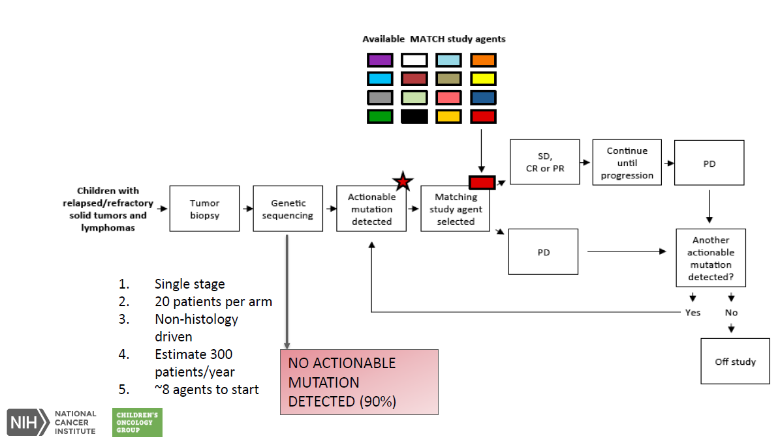
NCI-COG (Pediatric MATCH)
Accelerating Pediatric Drug Development – Friends of Cancer Research Forum (2017)

Slide 16
Oncology Pediatric Confirmatory Trials
Possible Master Protocol Option
Hematologic
Cancer
Phase 1b
Safety, tolerability, PK/PD
for each agent
Target 1
Target 2
Target 3
Target 4
open-label
randomize
Molecule 2.1
Molecule 2.2
Molecule 3.1
External Control Arm

Slide 17
Challenges in pediatric oncology trials to Meet Regulatory requirements
All age groups in one trial may not present sufficient representation of each age group
Internal competition of patients
Re-assign patients to a different agent after progression
External control may not be feasible or acceptable
Cancer agonistic concept is relatively new
Combination of two agents in the platform
Unethical to keep subjects on inferior treatments

Slide 18
Statistical Modeling and Simulation
Bayesian framework
  Leveraging external/historical data
  Fine-tune the level of borrowing based on similarity of the data
  Built-in simulation for operating characteristics
Simulation
  Scenario selection with rationale
  Results presentation

Slide 19
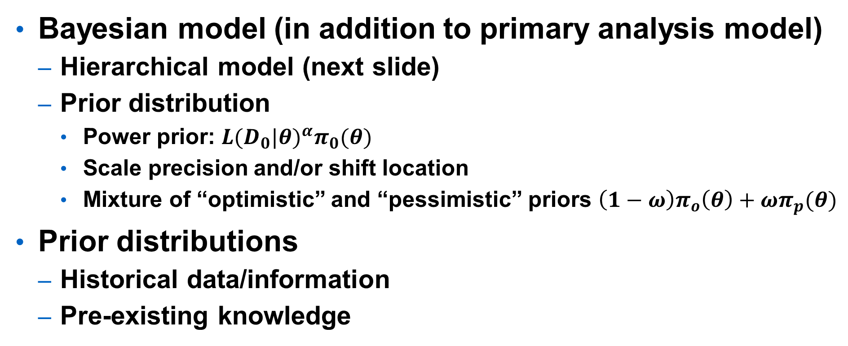
Bayesian Framework
Bayesian model (in addition to primary analysis model)
  Hierarchical model (next slide)
  Prior distribution
    Power prior: ${L(D_{0}|θ)}^{α}π_{0}(θ)$
    Scale precision and/or shift location
    Mixture of “optimistic” and “pessimistic” priors $\left(1−ω\right)π_{o}\left(θ\right)+ωπ_{p}(θ)$
Prior distributions
  Historical data/information
  Pre-existing knowledge

Slide 20
Hierarchical Model
Treatment Effect µ ~ prior
Adult Study 1
µ_{a1} ~ N(µ_{a}, .)
Adult Study 2
µ_{a2} ~ N(µ_{a}, .)
Peds Treatment Effect µ_{p} ~ N(k₂µ, .)
Peds Study 1
µ_{p1} ~ N(µ_{p}, .)
Peds Study 2
µ_{p2} ~ N(µ_{p}, .)
Adult Study 3
µ_{a3} ~ N(µ_{a}, .)
Adult Treatment Effect µ_{a} ~ N(k₁µ, .)

Slide 21
Summaries
Closing the gap between adult and pediatric indications
More work needed before implementation
  Guidance
  Collaboration
  Research / Planning / Simulation
Leveraging historical or external data could greatly improve trial efficiency
Learn as we go

